Slide 1

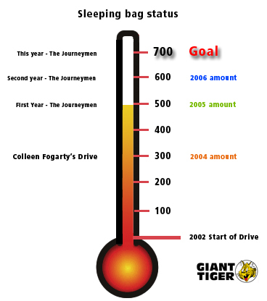

ONLY 200 TO GO
Dear friends:
The Journeymen, your men’s ministry, has decided to end this year’s “in HIS care” Sleeping Bags for the Homeless program on December 16th as these unfortunate souls need to receive the sleeping bags before the winter months when the extreme cold sets in. Christmas will soon be upon us and the focus will be more so on family than on the Homeless.
We would like to thank you and the support provided by Manotick United Church from the bottom of our hearts for the donations you have made and will be making to this worthy cause. We do however believe that with your kind support, our goal of 700 sleeping bags can be achieved.
We are so blessed to have had the opportunity to see one woman’s dream of keeping these poor people warm during the winter with a record 600 sleeping bags last year come to fruition that we at MUC praise the Lord for helping us to achieve it.
We will show our thermometer on the screen with the weekly status before Sunday services from now until and including December 16^{th.} Our donation booth will be at the back of the church counting on your support to get closer to the goal. Always Remember WWJD, “What Would Jesus Do?”
Bless you and have a Merry Christmas
Jesus loves you

